Slide 1
Cloud Computing for Big Data
Pravin Y Pawar

Slide 2
Motivation for Cloud Computing
Factors
Powerful multi-core processors
General purpose graphic processors
Superior software methodologies
Virtualization leveraging the powerful hardware
Wider bandwidth for communication
Proliferation of devices
Explosion of domain applications
Web Scale Problems
Web 2.0 and Social Networking
Information Explosion
Mobile Web

Slide 3
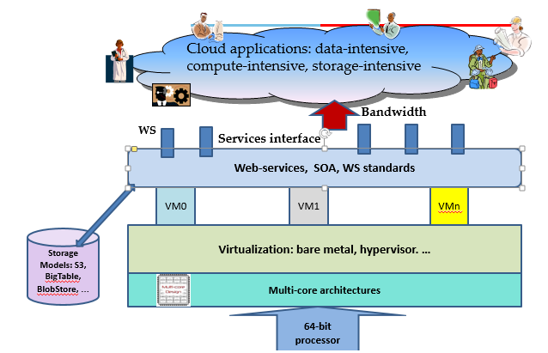
Motivation for Cloud Computing (2)
Technology Advances

Slide 4
Cloud Computing
Cloud Computing is a general term used to describe a new class of network based computing that takes place over the Internet,
basically a step on from Utility Computing
a collection/group of integrated and networked hardware, software and Internet infrastructure (called a platform).
Using the Internet for communication and transport provides hardware, software and networking services to clients
These platforms hide the complexity and details of the underlying infrastructure from users and applications by providing very simple graphical interface or API (Applications Programming Interface).
In addition, the platform provides on demand services, that are always on, anywhere, anytime and any place.
Pay for use and as needed, elastic
scale up and down in capacity and functionalities
The hardware and software services are available to
general public, enterprises, corporations and businesses markets

Slide 5
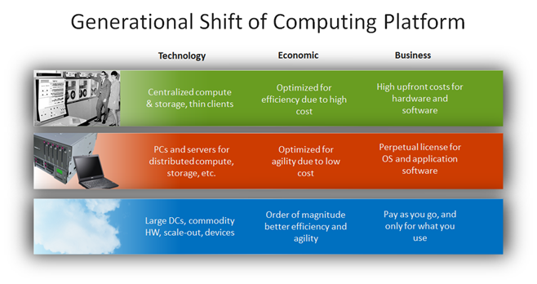
Drivers for the new Platform

Slide 6
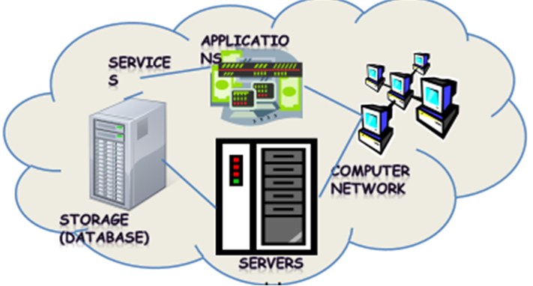
Cloud Simplified
Shared pool of configurable computing resources
On-demand network access
Provisioned by the Service Provider
Cloud computing is an umbrella term used to refer to Internet based development and services

Slide 7
Cloud Computing: Definition
The US National Institute of Standards (NIST) defines cloud computing as follows:
Cloud computing is a model for enabling ubiquitous, convenient, on-demand network access to a shared pool of configurable computing resources (e.g., networks, servers, storage, applications, and services) that can be rapidly provisioned and released with minimal management effort or service provider interaction.

Slide 8
3-4-5 rule of Cloud Computing
NIST specifies 3-4-5 rule of Cloud Computing
3 cloud service models or service types for any cloud platform
4 deployment models
5 essential characteristics of cloud computing infrastructure

Slide 9
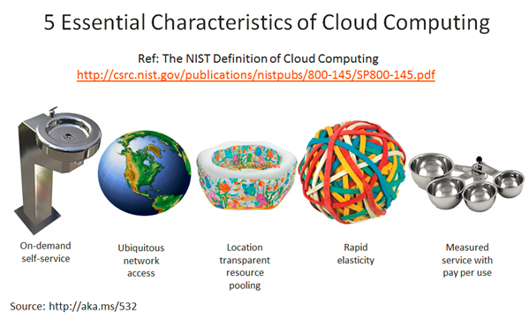
Characteristics of Cloud Computing
On demand self-service
Broad network access
Resource pooling
Rapid elasticity
Measured service

Slide 10
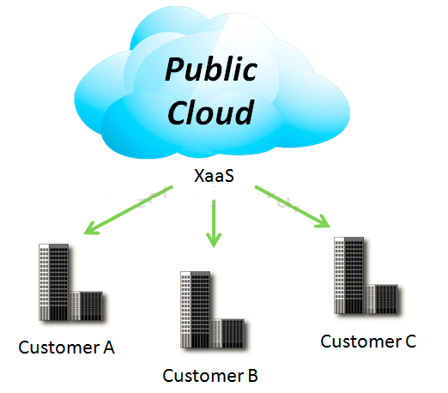
4 Deployment Models
1. Public Cloud
Mega-scale cloud infrastructure is made available to the general public or a large industry group and is owned by an organization selling cloud services.

Slide 11
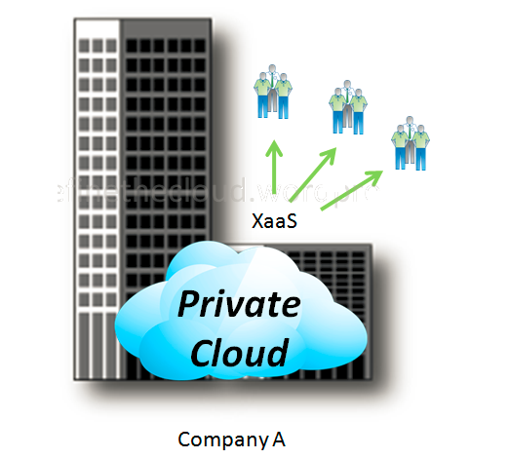
4 Deployment Models
2. Private Cloud
The cloud infrastructure is operated solely for an organization. It may be managed by the organization or a third party and may exist on premise or off premise.

Slide 12
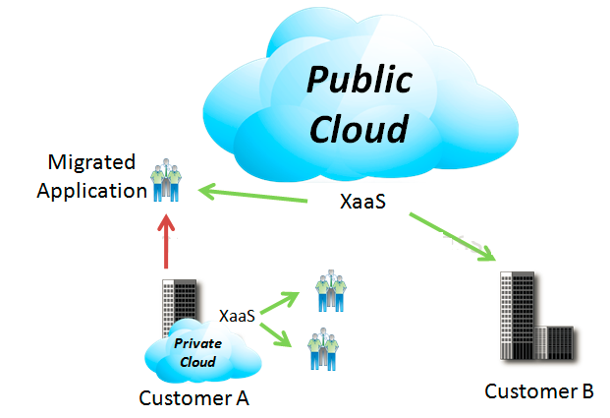
4 Deployment Models
3. Hybrid Cloud
The cloud infrastructure is a composition of two or more clouds (private or public) that remain unique entities but are bound together by standardized or proprietary technology that enables data and application portability

Slide 13
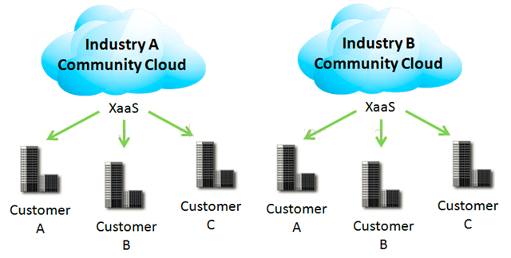
4 Deployment Models
4. Community Cloud
Community Clouds are when an ‘infrastructure is shared by several organizations and supports a specific community that has shared concerns (e.g., mission, security requirements, policy, and compliance considerations). It may be managed by the organizations or a third party and may exist on premise or off premise’ according to NIST.
A community cloud is a cloud service shared between multiple organizations with a common tie/goal/objective.
E.g. OpenCirrus

Slide 14
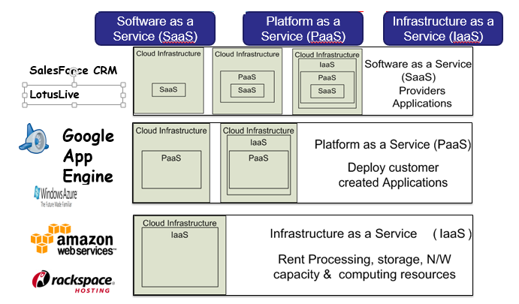
3 Cloud Service Models

Slide 15
3 Cloud Service Models
Cloud Software as a Service (SaaS)
The capability provided to the consumer is to use the provider’s applications running on a cloud infrastructure and accessible from various client devices through a thin client interface such as a Web browser (e.g., web-based email). The consumer does not manage or control the underlying cloud infrastructure, network, servers, operating systems, storage, or even individual application capabilities, with the possible exception of limited user-specific application configuration settings.
Cloud Platform as a Service (PaaS)
The capability provided to the consumer is to deploy onto the cloud infrastructure consumer-created applications using programming languages and tools supported by the provider (e.g., Java, Python, .Net). The consumer does not manage or control the underlying cloud infrastructure, network, servers, operating systems, or storage, but the consumer has control over the deployed applications and possibly application hosting environment configurations.
Cloud Infrastructure as a Service (IaaS)
The capability provided to the consumer is to rent processing, storage, networks, and other fundamental computing resources where the consumer is able to deploy and run arbitrary software, which can include operating systems and applications. The consumer does not manage or control the underlying cloud infrastructure but has control over operating systems, storage, deployed applications, and possibly select networking components (e.g., firewalls, load balancers).

Slide 16
Cloud Services for Big Data
Cloud follows same model as Big Data, both requiring distributed clusters of computing devices.
Cloud Computing considered as ideal platform for handling big data
In Big Data and Cloud world:
IaaS :
Can provide huge storage and computational power requirements for Big Data through limitless storage and computing ability of cloud computing
PaaS:
Vendors offers platforms ready with Hadoop and MapReduce.
Saves hassles of installations and managements of these environments
SaaS:
Great help to organizations which requires specialized software's for big data like for social media analytics, feedback monitoring etc.
SaaS vendors provides out of the box solution for such common use cases

Slide 17
Cloud Providers in Big Data Market
Amazon (Amazon Web Services AWS)
EC2
Elastic MapReduce
DynamoDB
Amazon S3
High Performance Computing
Redshift
Google (Google Cloud Platform GCP)
Google Compute Engine
Google BigQuery
Google Prediction API
Windows Azure
Azure PaaS cloud based on Windows and SQL
Windows Azure HD Insight

Slide 18
Thank You!
Reference :
Some content adapted from SEWP ZG527 Cloud Computing
In our next session: In-Memory Computing for Big Data

